Slide 1
Crime in Berlin 2012-2019
Şelale & Milena
Berlin, 10.07.2020
Data Sources:
Amt für Statistik Berlin-Brandenburg
Kriminalitätsatlas Berlin

Slide 2
Questions
Types of Crime in Berlin
What crime types are the most common in Berlin?
Can crime be correlated to the areas of districts, population size,or number of tourists?
Spatial Distribution of Crime
What are the differences between districts?
What are the ‘dangerous’ neighbourhoods in Berlin?
Diachronic Overview of Crime
5. Does and in what ways crime rate change through time?

Slide 3
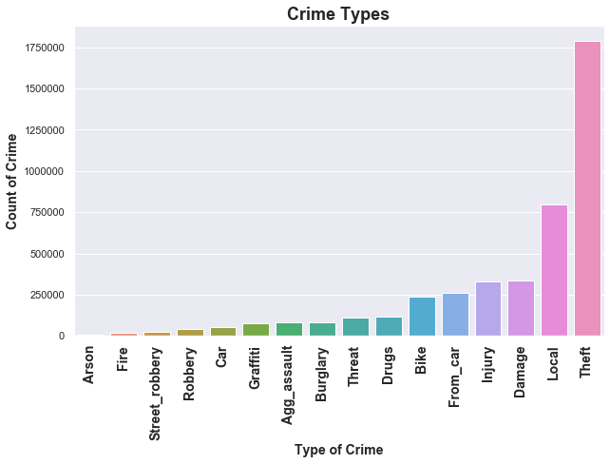
What Crime Types are the Most Common?
01

Slide 4
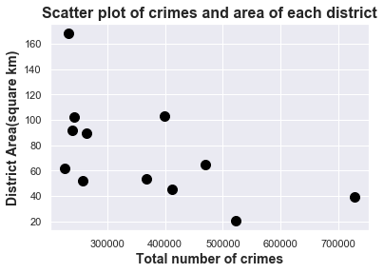
Can Crime be Correlated to the Area of District ?
02
Result: Moderate Negative Correlation
(r= -0.57)

Slide 5
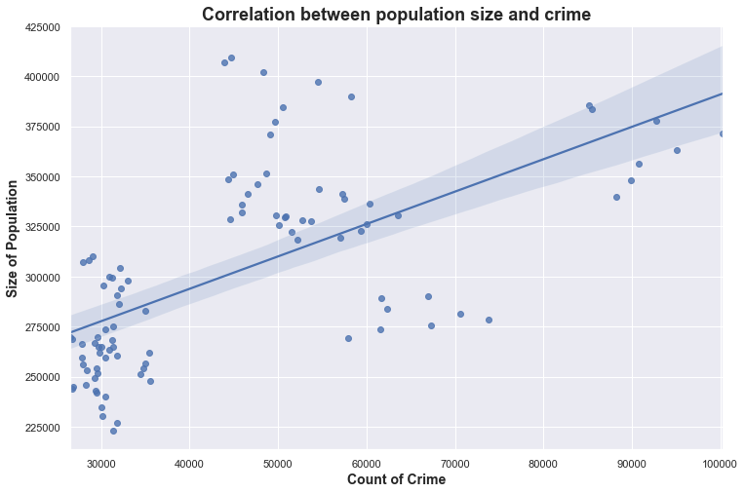
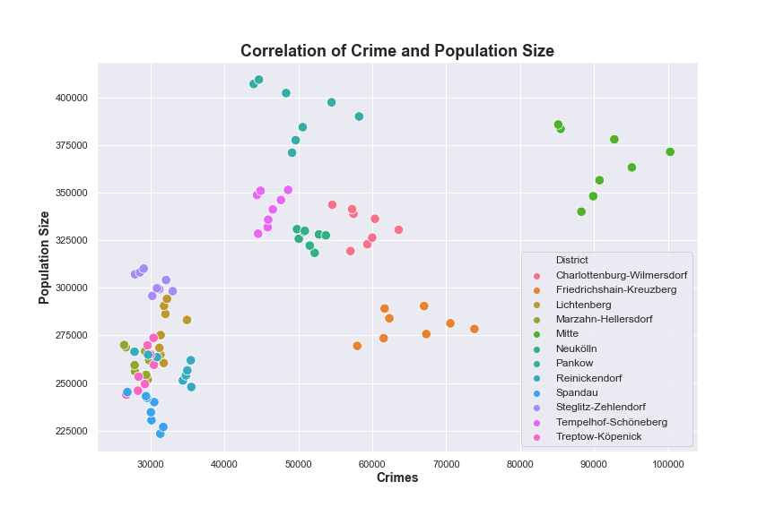
Can Crime be Correlated to the Size of Population?
02
Result: Moderate Positive Correlation
(r = 0.63)

Slide 6
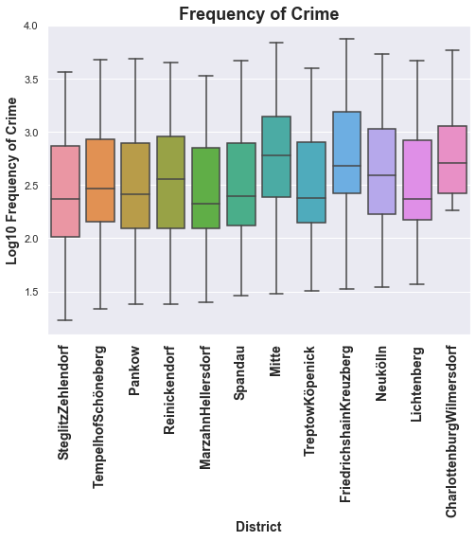
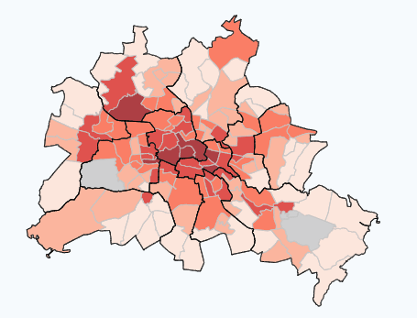
What are the differences among districts?
Crime Frequency: Number of Crimes per 100k people
03
Crime Frequency
Source:
https://www.kriminalitaetsatlas.berlin.de/K-Atlas/atlas.html

Slide 7
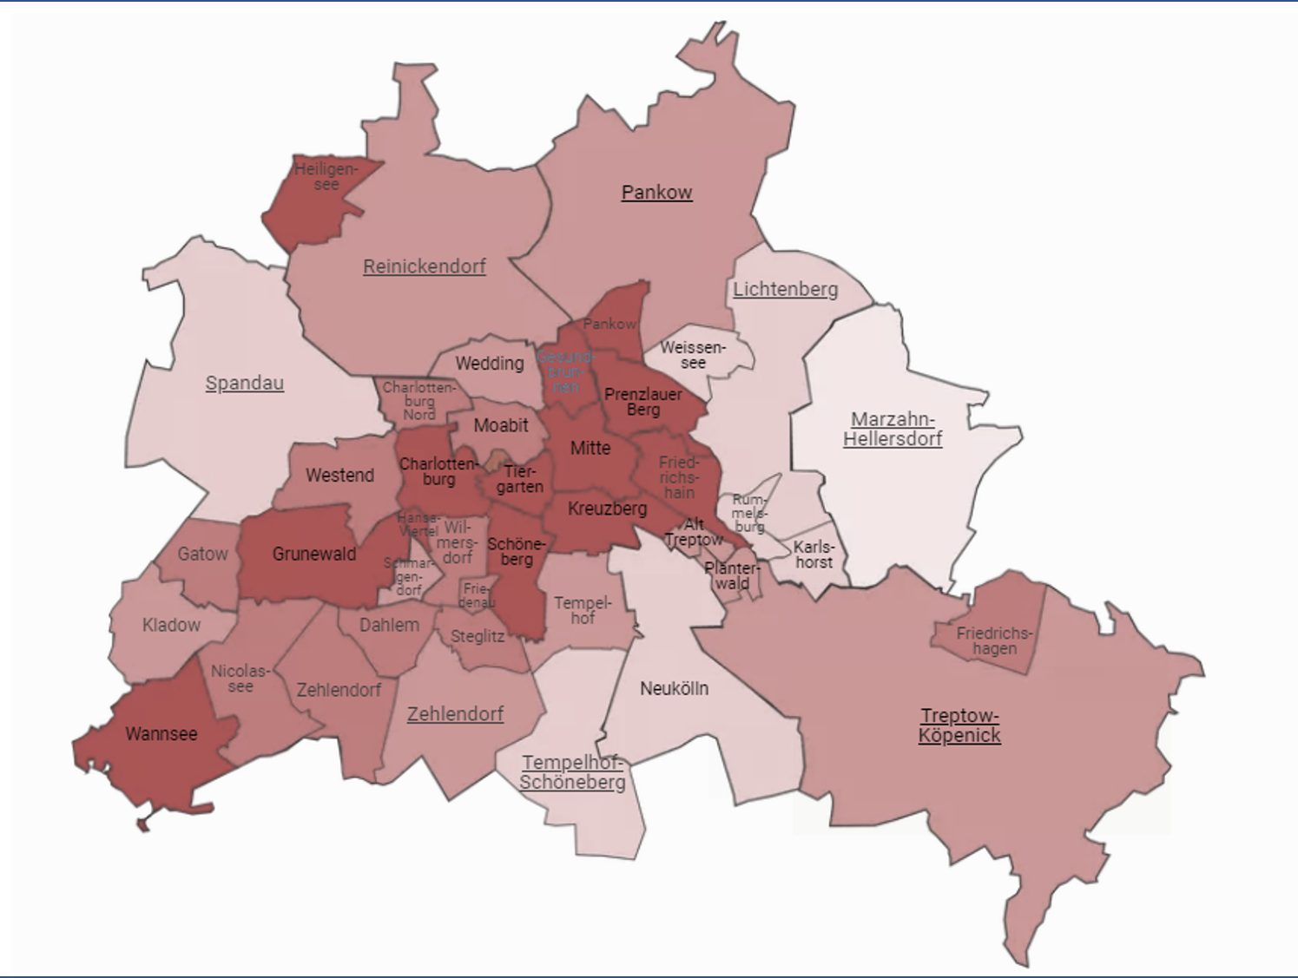
What are the differences among districts?
Crime Frequency: Number of Crimes per 100k people
03
‘Tourist Attractions’
Source:
https://the-red-relocators.com/wp-content/uploads/Berlin-districts.png

Slide 8
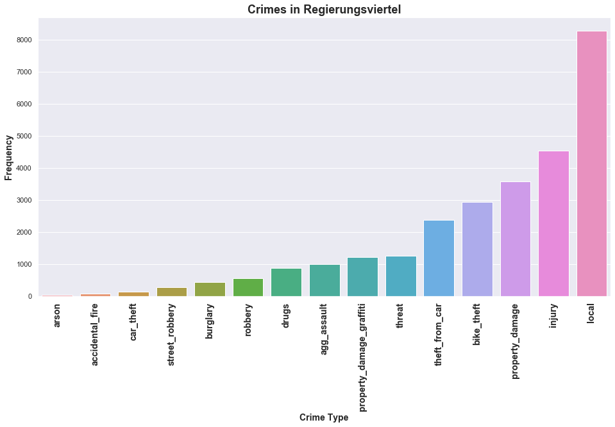
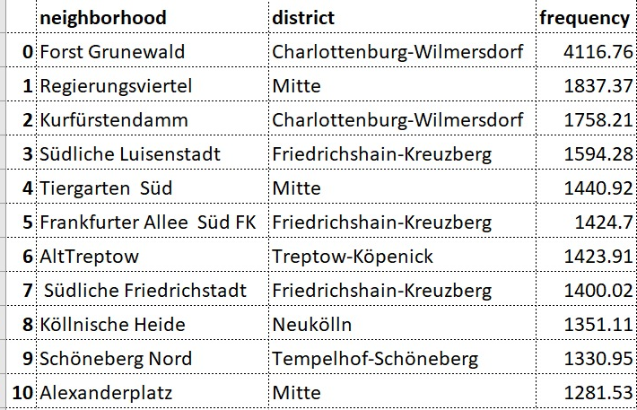
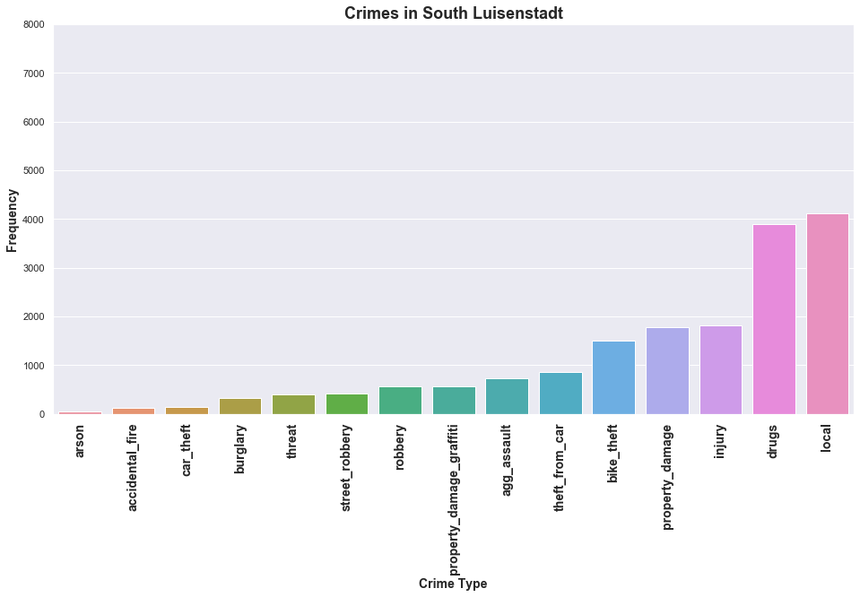
What are the Most ‘Dangerous’ Neighbourhoods?
Crime Frequency: Number of Crimes per 100k people
04
Crime Frequency: Number of Crimes per 100k people

Slide 9
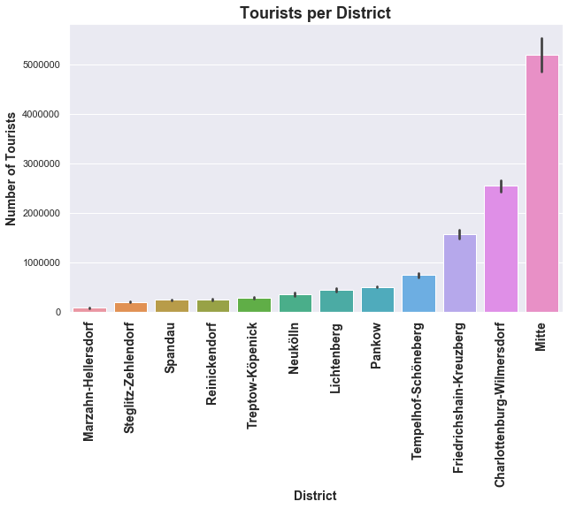
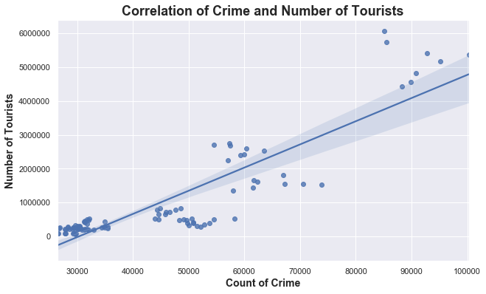
Can Crime be Correlated to the Number of Tourists?
05
Result: Strong Positive Correlation
(r = 0.89)
Tourists & Population & Area & Crime:
Adj. R-squared = 0.870

Slide 10
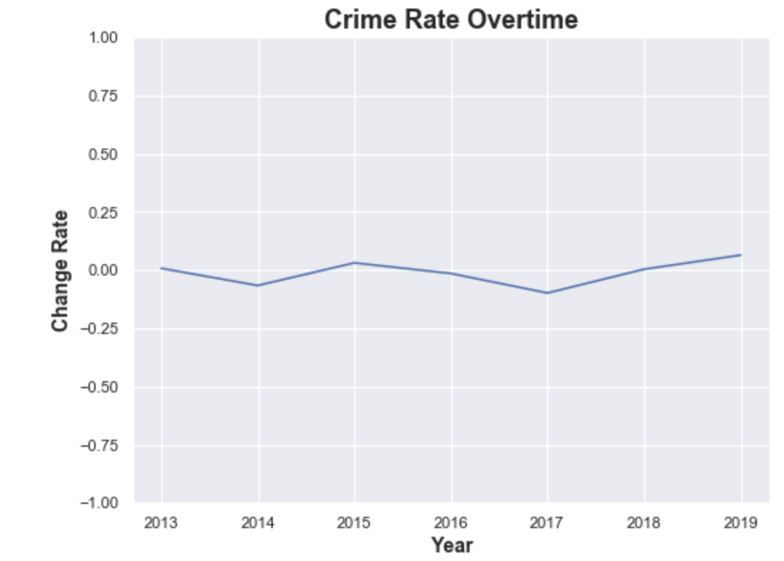
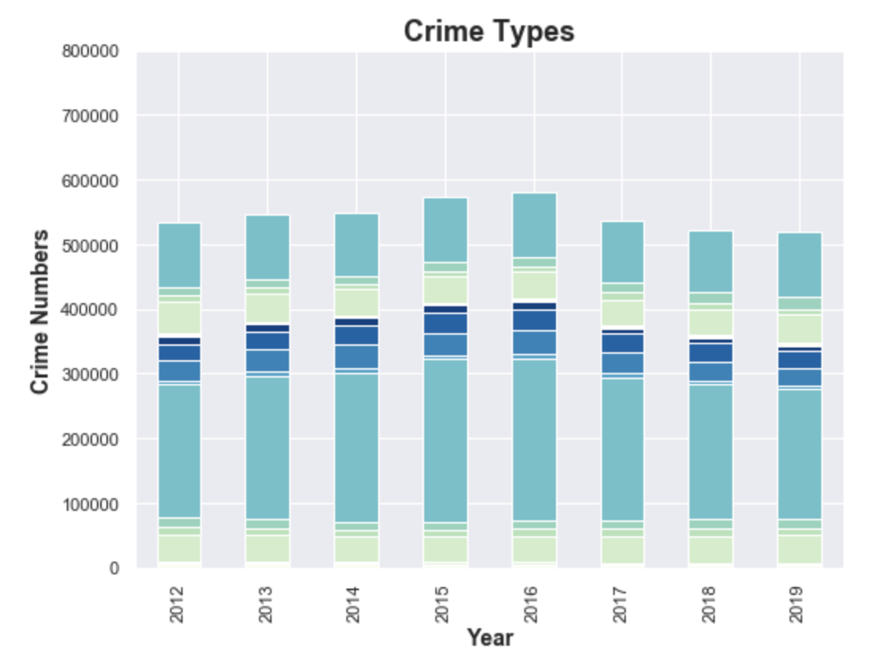
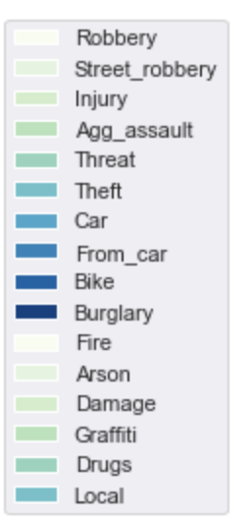
What is the Temporal Trend of Crimes?
Crime Frequency: Number of Crimes per 100k people
06

Slide 11
Thank you!

